Slide 1
Computational Physics
(Lecture 8)
PHY4061

Slide 2
The similarity transformation preserves the eigenvalues of the original matrix,
  the eigenvectors are the columns or rows of the orthogonal matrix used in the transformation.
Householder method.
  Givens method.
  The most commonly used for tridiagonalizing
  achieved with a total of n − 2 consecutive transformations, each operating on a row and a column of the matrix.

Slide 3
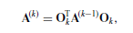
The transformations can be cast into a recursion:
  for k = 1, 2, . . . , n − 2, where O_{k} is an orthogonal matrix that works on the row elements with i = k + 2, . . . , n of the kth column and the column elements with j = k + 2, . . . , n of the kth row. The recursion begins with A⁽⁰⁾ = A.
  It is an O(N) algorithm.
  Storage advantages.

Slide 4
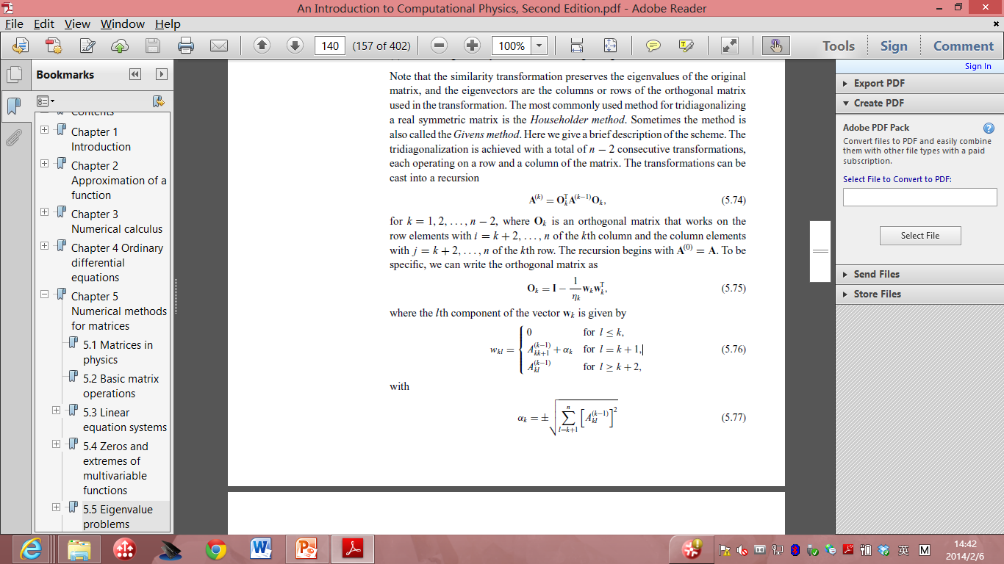
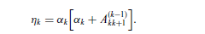
Here:
  Where the ith component of the vector w_{k} is given by
    with

Slide 5
Provided in standard math libraries. So we don’t have to reinvent the wheel here. Just take the code from most standard math libraries.
After we obtain the tridiagonalized matrix, the eigenvalues can be found using one of the root search routines available.
  Note that the secular equation |A − λI| = 0 is equivalent to a polynomial equation p_{n}(λ) = 0.
  Because of the simplicity of the symmetric tridiagonal matrix, the polynomial p_{n}(λ) can be generated recursively with:

Slide 6
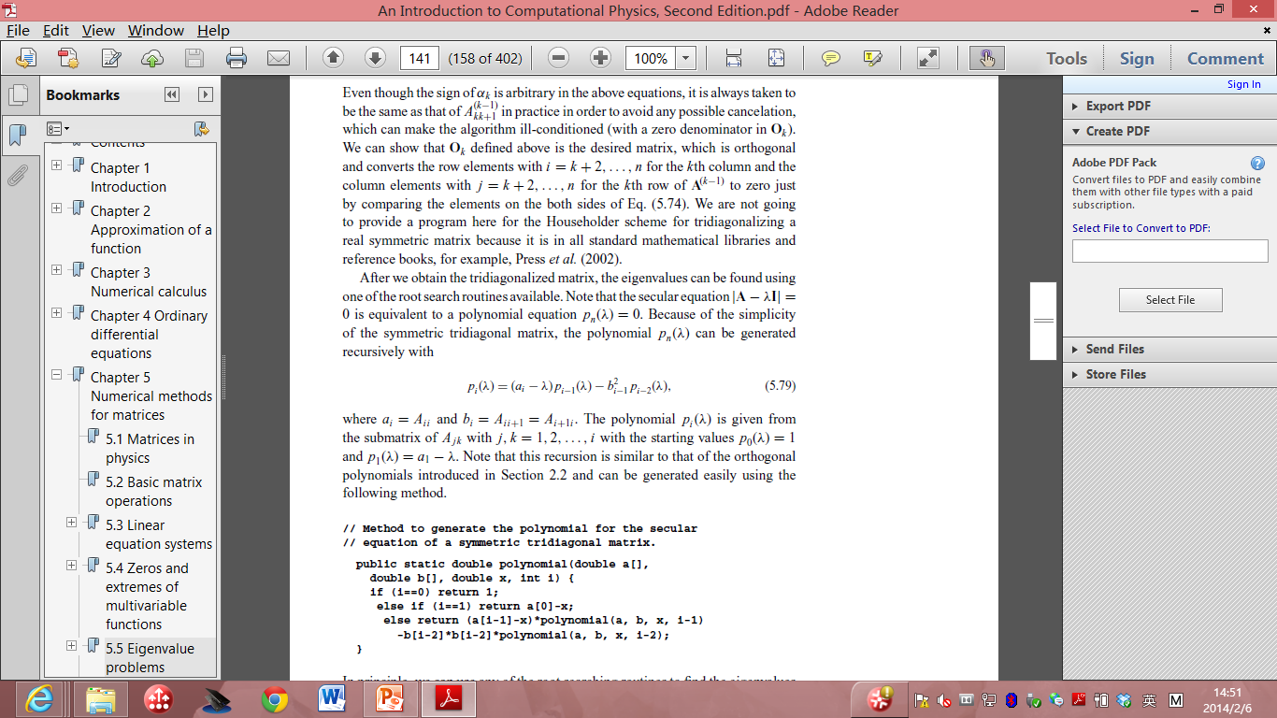
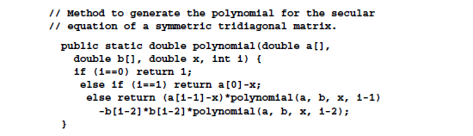
Where a_{i} = A_{ii} and b_{i} = A_{ii+1}=A_{i+1i}.
The polynomial is given from the submatrix of A_{jk} with j, k = 1,2…,i with the starting value p₀(λ) =1
And p₁(λ)=a₁ - λ.

Slide 7
In principle, we can use any of the root searching routines to find the eigenvalues from the secular equation
  as soon as the polynomial is generated.
However, two properties associated with the zeros of p_{n}(λ) are useful in developing a fast and accurate routine to obtain the eigenvalues of a symmetric tridiagonal matrix.
Will not be covered in this lecture. If interested, you can read T. Pang book.

Slide 8
The Faddeev--Leverrier method
A very interesting method developed for matrix inversion and eigenvalue problem.
The scheme was first discovered by Leverrier in the middle of the nineteenth century
modified by Faddeev (Faddeev and Faddeeva, 1963).

Slide 9
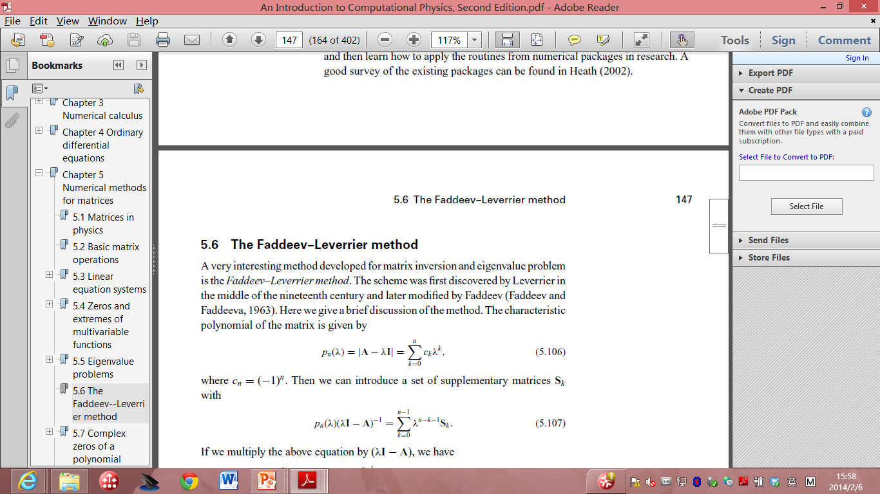

The characteristic polynomial of the matrix is given by
  where c_{n} = −1^{n}.
we can introduce a set of supplementary matrices S_{k} with

Slide 10
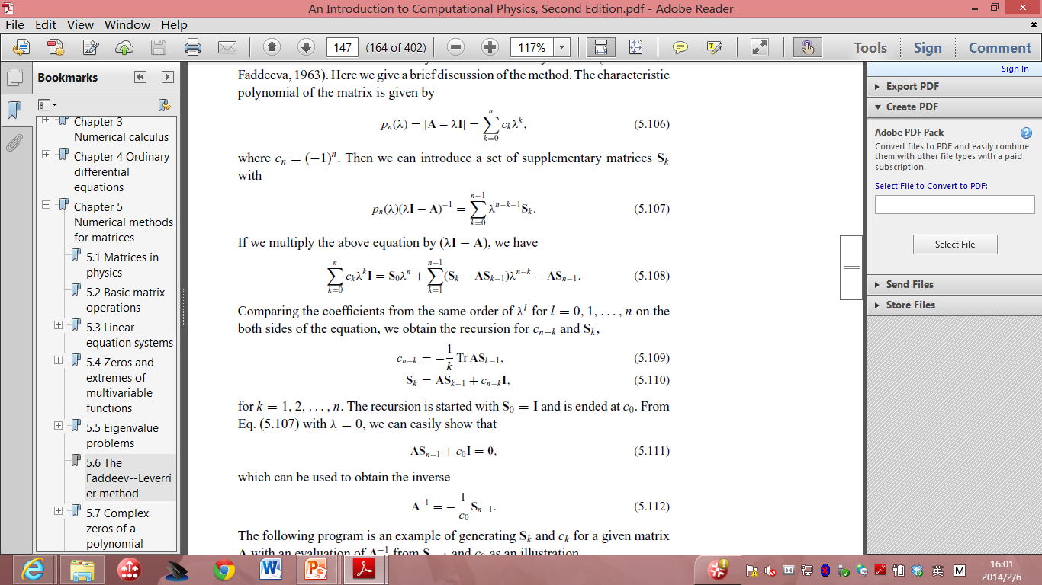
If we multiply the above equation by (λ I – A), we have:
Comparing the coefficients from the same order of λ ^{l} for l = 0, 1,…n on the both sides of the equation, we obtain the recursion:
  For k = 1, 2, …, n. The recursion is started with S₀ = I is ended at c₀.
  With λ = 0, we can show that

Slide 11
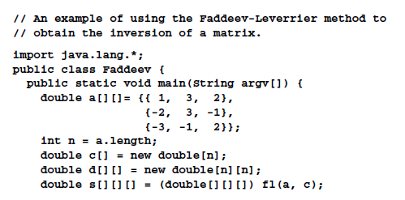
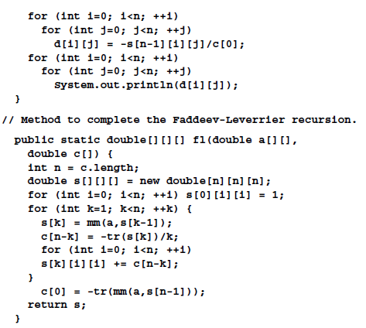
Mistake in the code!
The correct one should be
c[0] = -tr(mm(a,s[n-1]))/n;

Slide 12
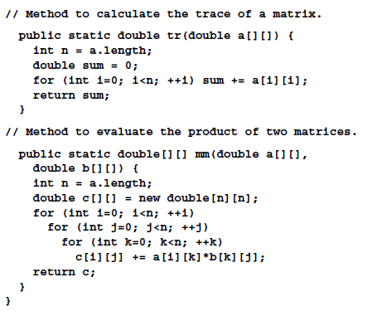

Slide 13
Because the Faddeev–Leverrier recursion also generates all the coefficients c_{k} for the characteristic polynomial p_{n}(λ),
we can use a root search method to obtain all the eigenvalues from p_{n}(λ) = 0.

Slide 14
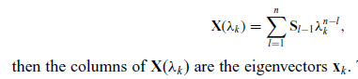
After we have found all the eigenvalues λ_{k} , we can also obtain the corresponding eigenvectors with the availability of the supplementary matrices S_{k}.

Slide 15
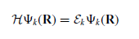

Electronic structures of atoms
The Schrodinger equation for a multi-electron atom is given by

Slide 16
Hartree Fock Approximations
The Born–Oppenheimer approximation is inherently assumed.
Typically, relativistic effects are completely neglected.
The variational solution is assumed to be a linear combination of a finite number of basis functions.
Each energy eigenfunction is assumed to be describable by a single Slater determinant
The mean field approximation is implied. Effects arising from deviations from this assumption, known as electron correlation, are completely neglected for the electrons of opposite spin, but are taken into account for electrons of parallel spin.

Slide 17
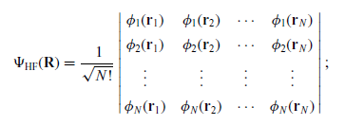
the ground state is approximated by the Hartree–Fock ansatz, which can be cast into a determinant

Slide 18
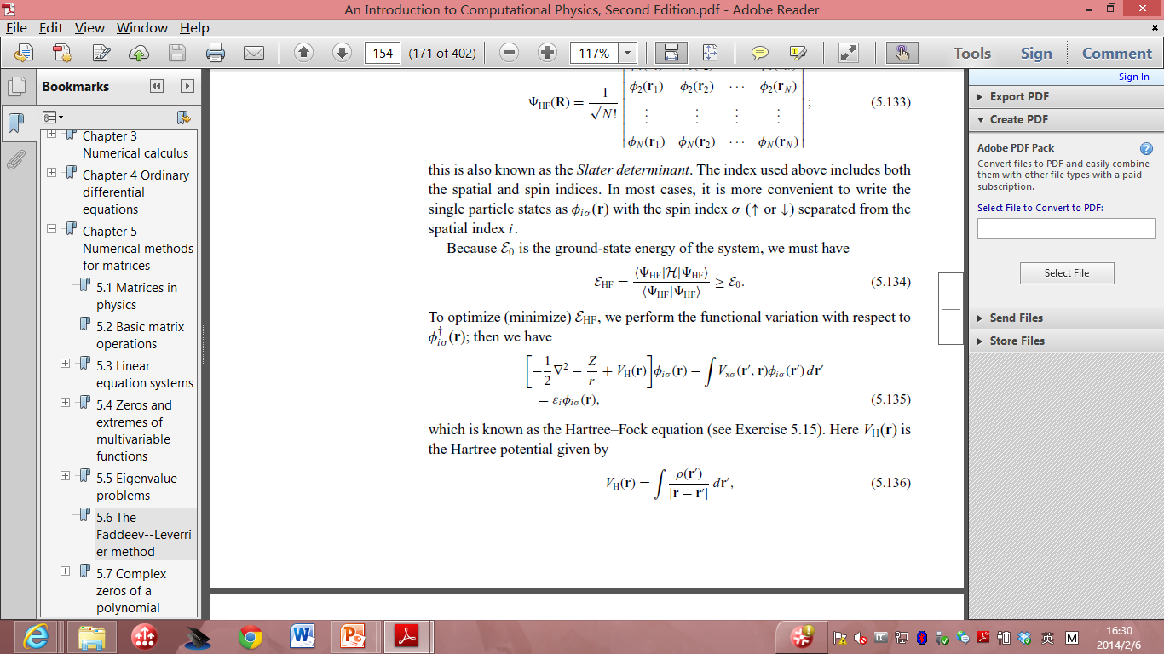
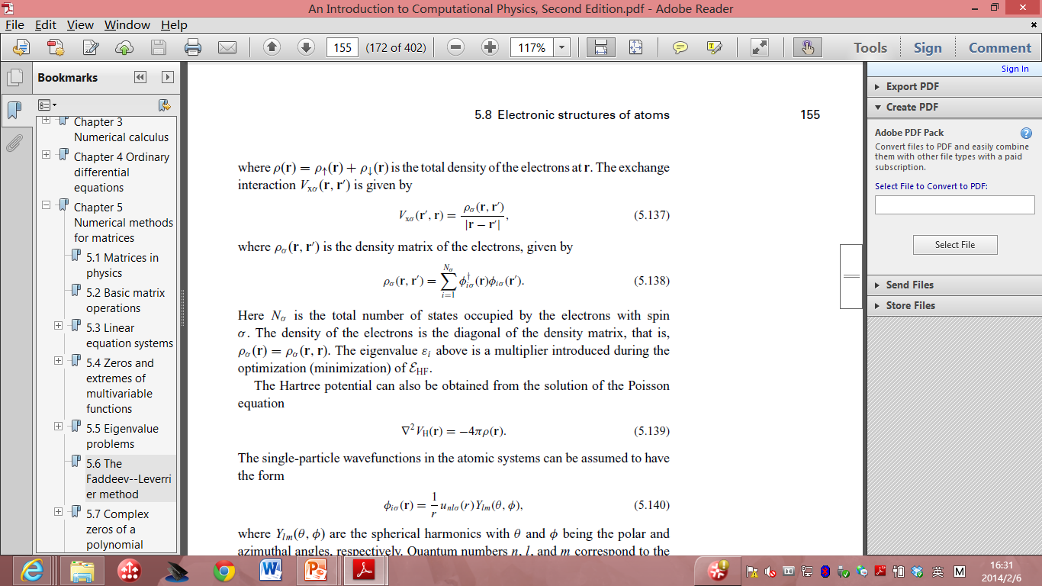
To optimize (minimize) E_{HF}, we can perform the functional variation with respect to
  Hartree-Fock equation.
  V_{H}(R) (HF potential) is given by:
  Where: is the total density of the electron at r.
  The exchange correlation is given by:

Slide 19
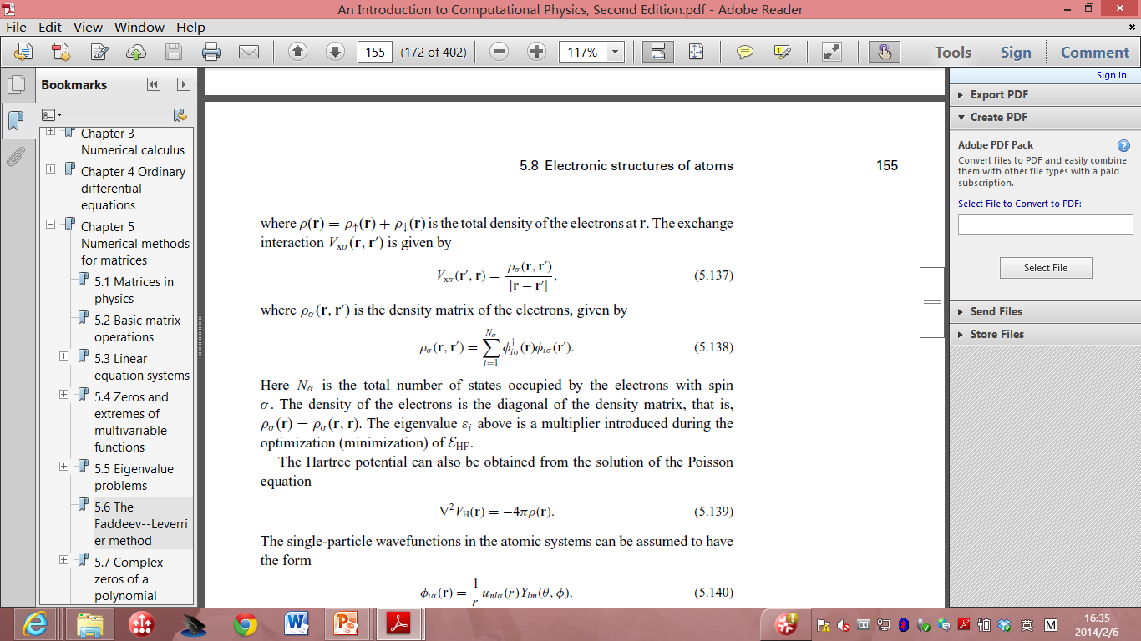
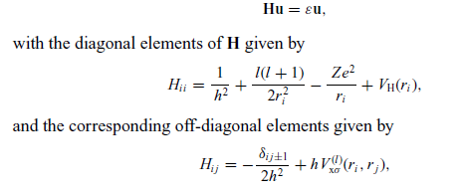
The Hartree potential can also be obtained from the solution of the Poisson equation:
The single particle wavefunctions in the atomic systems can be assumed to have the form:
The H-F equation for given l can be further converted into:

Slide 20
We can easily apply the numerical schemes introduced in this lecture to solve this matrix eigenvalue problem.

Slide 21
Inverse of a matrix
What’s the most straightforward way to inverse a matrix?

Slide 22
Inverse of a matrix
The inverse of a matrix A using linear equating approach: A⁻¹ _{i j} = x_{i j} ,
  for i, j = 1, 2, . . . , n,
    where x_{i j} is the solution of the equation Ax_{j} = b_{j} , with b_{i j} = δ_{i j} .
If we expand b into a unit matrix in the program for solving a linear equation set,
  the solution corresponding to each column of the unit matrix forms the corresponding column of A⁻¹

Slide 23
// An example of performing matrix inversion through the
// partial-pivoting Gaussian elimination.
import java.lang.*;
public class Inverse {
public static void main(String argv[]) {
double a[][]= {{ 100, 100, 100},
{-100, 300, -100},
{-100, -100, 300}};
int n = a.length;
double d[][] = invert(a);
for (int i=0; i<n; ++i)
for (int j=0; j<n; ++j)
System.out.println(d[i][j]);
}
public static double[][] invert(double a[][]) {
int n = a.length;
double x[][] = new double[n][n];
double b[][] = new double[n][n];
int index[] = new int[n];
for (int i=0; i<n-1; ++i)
for (int j=i+1; j<n; ++j)
for (int k=0; k<n; ++k)
b[index[j]][k]
-= a[index[j]][i]*b[index[i]][k];
// Perform backward substitutions
for (int i=0; i<n; ++i) {
x[n-1][i] = b[index[n-1]][i]/a[index[n-1]][n-1];
for (int j=n-2; j>=0; --j) {
x[j][i] = b[index[j]][i];
for (int k=j+1; k<n; ++k) {
x[j][i] -= a[index[j]][k]*x[k][i];
}
x[j][i] /= a[index[j]][j];
}
}
return x;
}
public static void gaussian(double a[][], int index[])
{...}
}
for (int i=0; i<n; ++i) b[i][i] = 1;
// Transform the matrix into an upper triangle
gaussian(a, index);
// Update the matrix b[i][j] with the ratios stored

Slide 24
LU decomposition
A scheme related to the Gaussian elimination is called LU decomposition,
  which splits a nonsingular matrix into the product of a lower-triangular and an upper-triangular matrix.
the Gaussian elimination corresponds to
  a set of n − 1 matrix operations that can be represented by a matrix multiplication
  A^{n−1} = MA,
  where
  M = M^{n−1}M^{n−2} · · ·M¹,
  with each M^{r}, for r = 1, 2, . . . , n − 1, completing one step of the elimination.

Slide 25
It s easy to show that M is a lower-triangular matrix with all the diagonal elements being −1 and M^{k}_{i j} = −A ^{j−1}_{k_i j} /A ^{j−1}_{k_ j j} for i > j .
So A = LU, where U = A^{n−1} is an upper-triangular matrix and L = M⁻¹ is a lower-triangular matrix.

Slide 26
Furthermore, because M_{ii} = −1, we must have L_{ii} = 1 and L_{i j} = −M_{i j} = A ^{j−1}_{ki j} /A ^{j−1}_{k j j} for i > j ,
  which are the ratios stored in the matrix in the method introduced earlier in this section to perform the partial-pivoting Gaussian elimination.

Slide 27
The method performs the LU decomposition with nonzero elements of U and nonzero, nondiagonal elements of L stored in the returned matrix.
The choice of L_{ii} = 1 in the LU decomposition is called the Doolittle factorization.
An alternative is to choose U_{ii} = 1; this is called the Crout factorization.
  The Crout factorization is equivalent to rescaling U_{i j} by U_{ii} for i < j and multipling L_{i j} by U_{j j} for i > j from the Doolittle factorization.

Slide 28
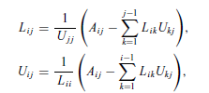
In general the elements in L and U can be obtained from comparison of the elements of the product of L and U with the elements of A.
The result can be cast into a recursion with
where L_i1 = A_i1/U_11 and U_1 j = A_1 j /L11 are the starting values.

Slide 29
We can apply the same pivoting technique and store the L and U values at the zero component of the matrix.
The determinant of A is given by the product of the diagonal elements of L and U because |A| = |L||U|

Slide 30
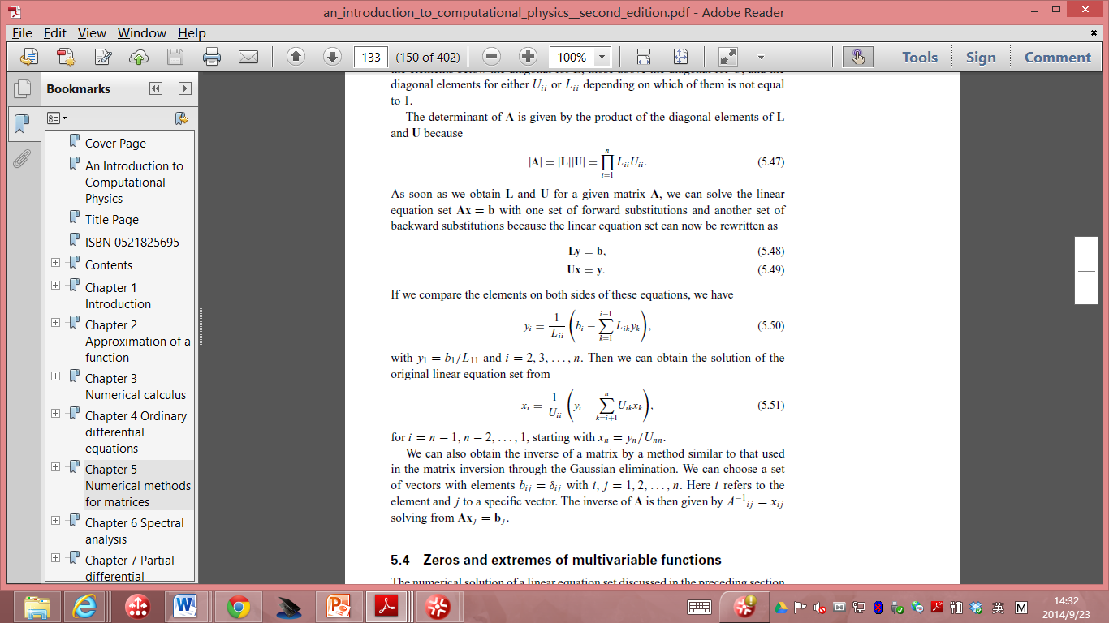
As soon as we obtain L and U for a given matrix A, we can solve the linear equation set Ax = b with one set of forward substitutions and another set of backward substitutions
  the linear equation set can now be rewritten as
    Ly = b, Ux = y.
If we compare the elements on both sides of these equations, we have
  with y₁ = b₁/L₁₁ and i = 2, 3, . . . , n.

Slide 31
We can obtain the solution of the original linear equation set from
for i = n − 1, n − 2, . . . , 1, starting with x_n = y_n/U_nn.

